Slide 1
Ethical Hacking Final cosc 6840 Hardware Security Assessment
Kevin Umba
12/9/2025

Slide 2
Agenda
Executive Summary
Methodology
Findings
Risks and Fixes
Script and Demo
Recommendations

Slide 3
EXeCUTIVE SUMMARY
Objective: ThanosTech LLC - The objective is to uncover weaknesses, of IoT devices and recommend fixes.
Major Findings: Unprotected UART Debug Shell & weak password, exposed flash memory.
Devices: STM32F103C8T6 Microcontroller (MCU), Winbond W25Q64JV External SPI Flash
Recommended Next step: strongly advice to recall devices as these vulnerabilities are easily actionable and may lead to massive intellectual property and revenue loss.
Risk | Description | Device | Mitigation
High | Unprotected UART peripheral exposing development information, credentials | MCU | Disable or solder UART pins Use secure bootloader
High | Weak password exposed in debug shell | MCU | Salted hashing and password complexity Rotate & Revoke passwords
High | Flash memory exposed potentially leaking firmware | MCU & Winbond | Use RDP1

Slide 4
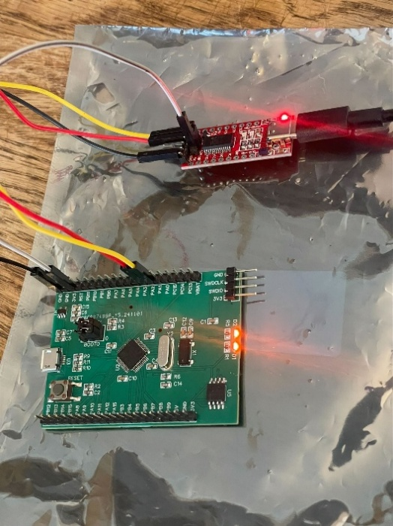
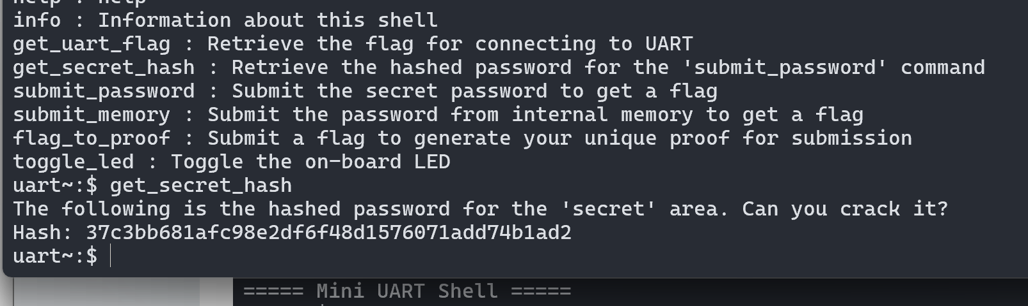
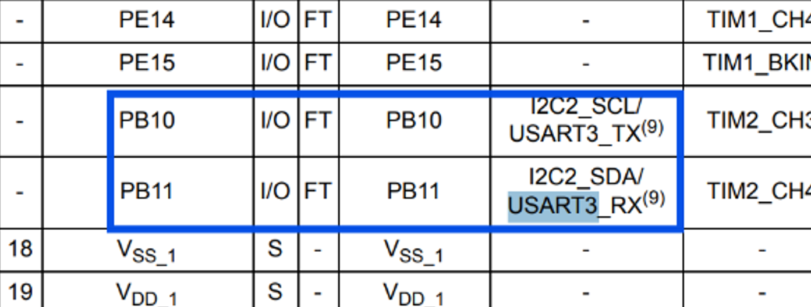
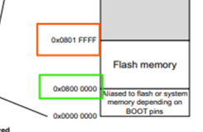
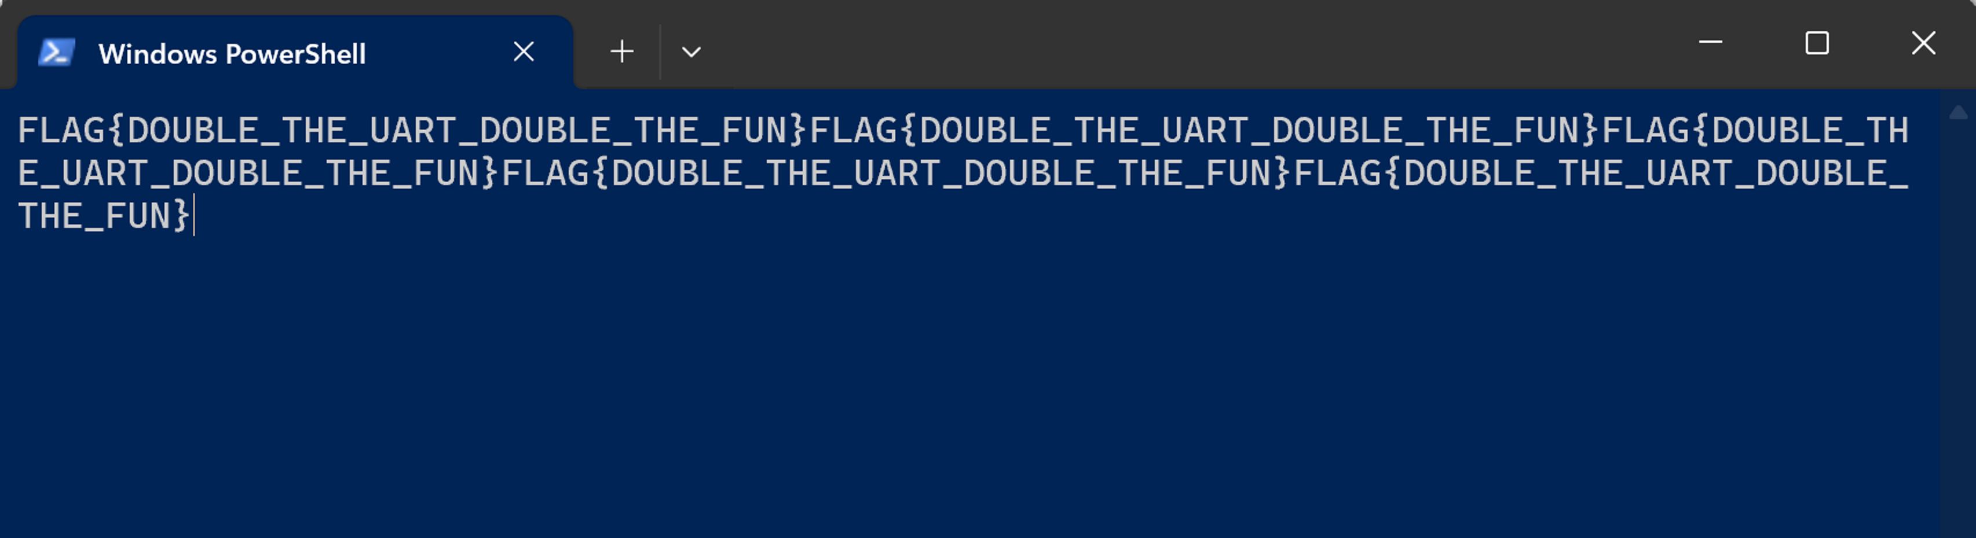
MEthodology
OSINT & Device Info
Collected device connection layout, memory mapping, UART data streams via manufacturer datasheets
UART Data Streams (Finding 1&5)
Tools: FT232 USB-UART adapter, screen, usbipd
Investigated default USART pins at different baud rates to access debug and secret data streams.

Slide 5
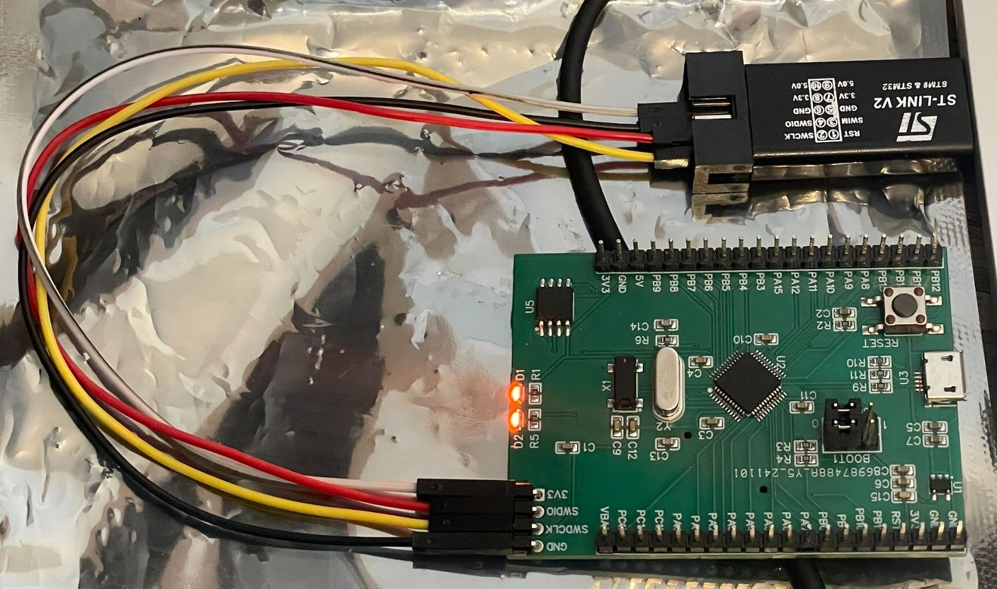
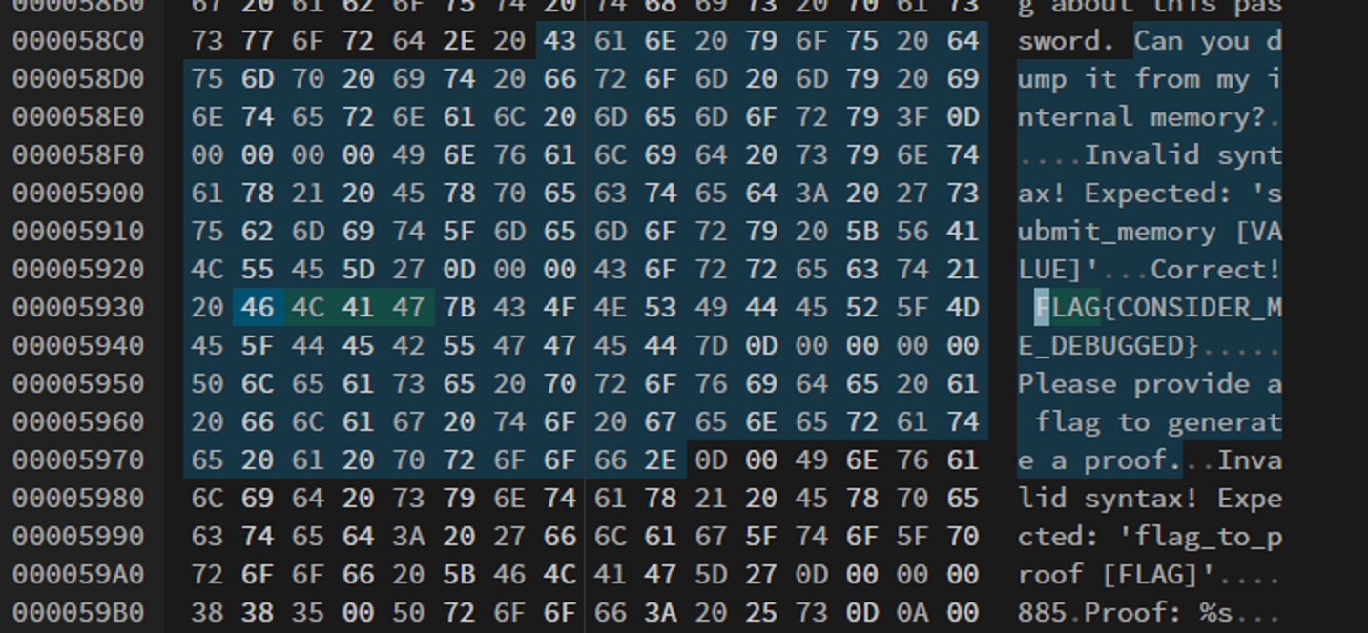
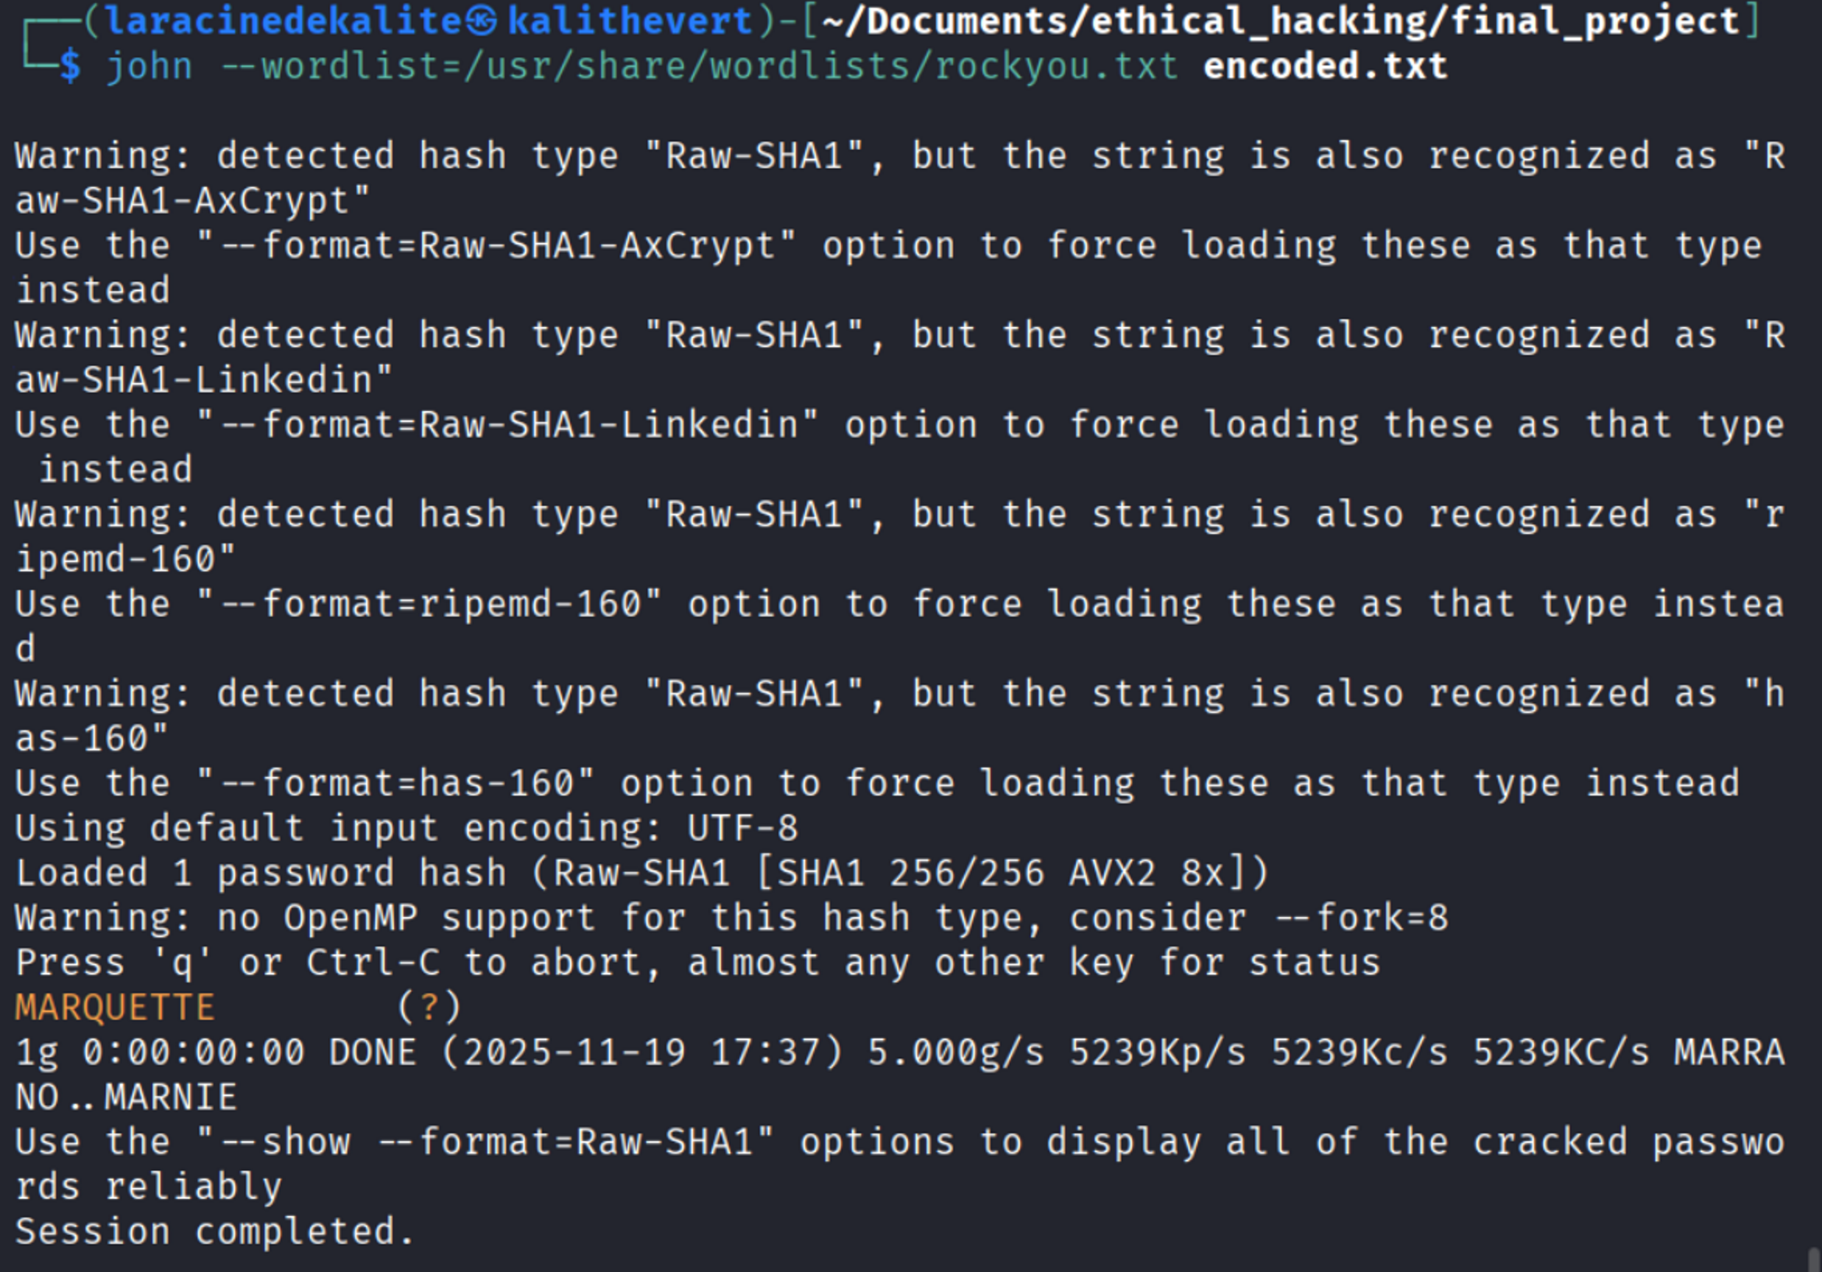
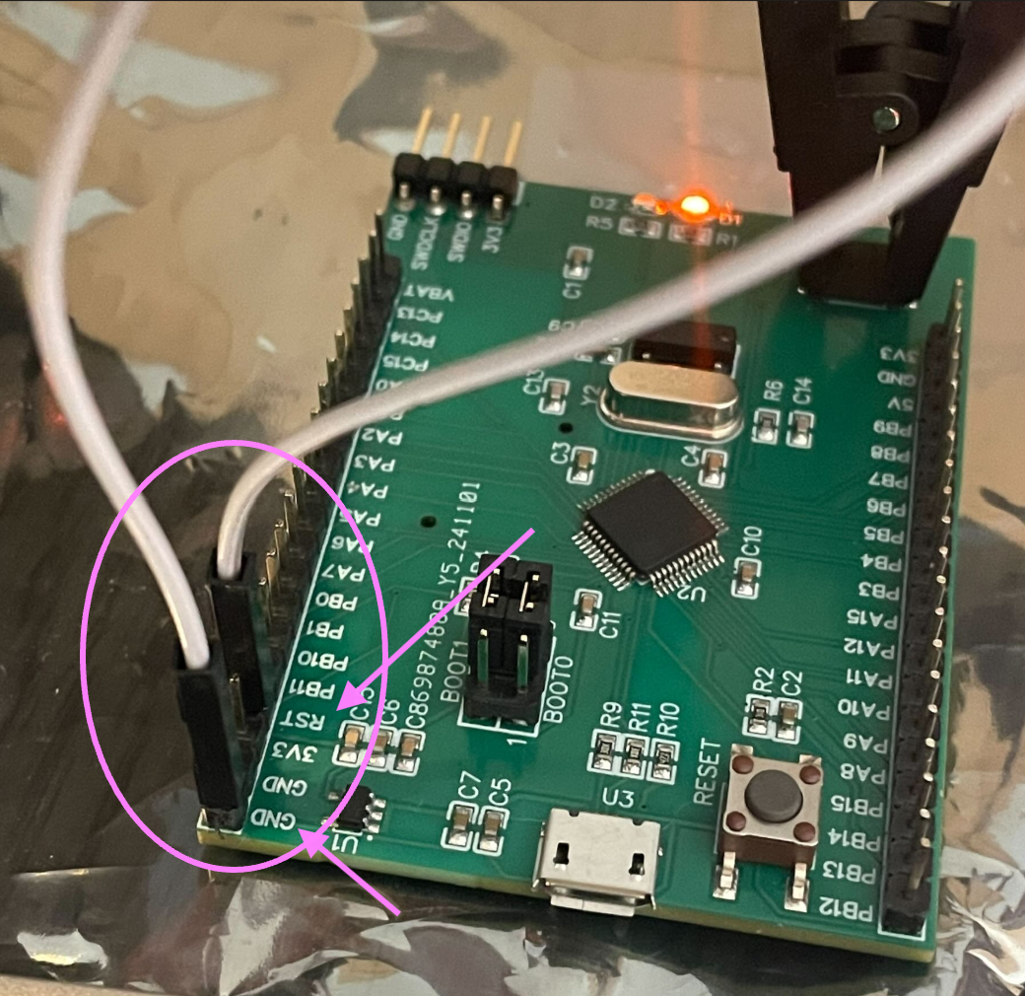
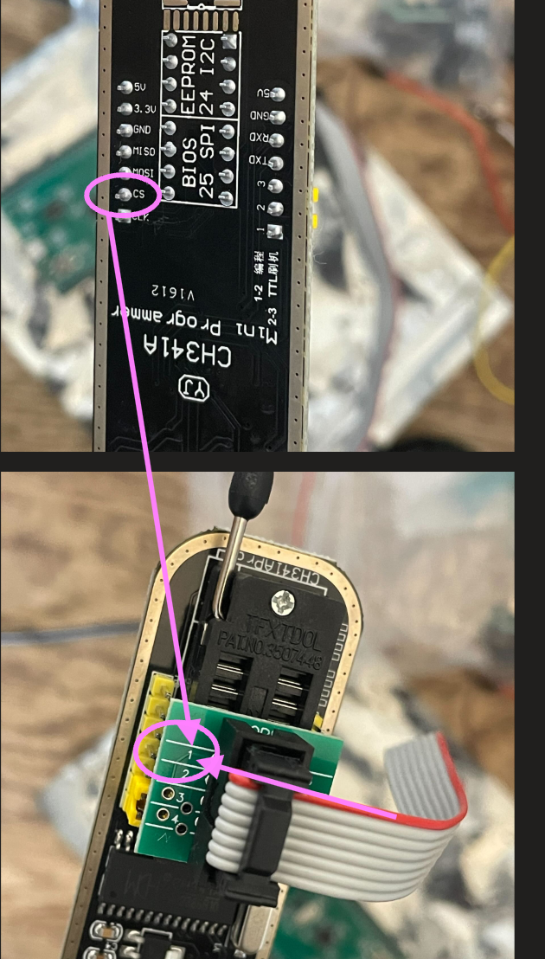
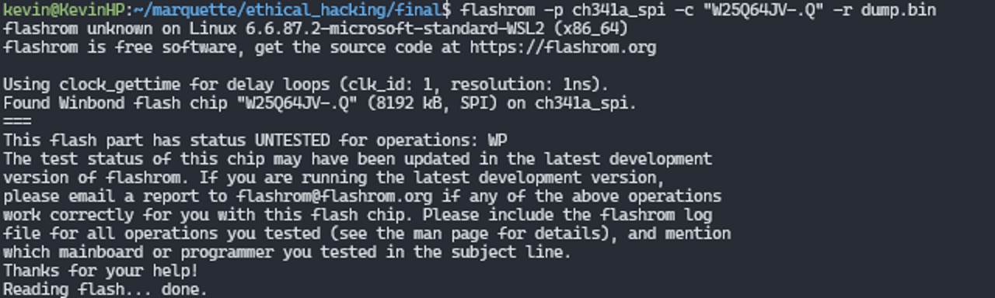
MEthodology
Password Extraction (Finding 2)
Tools: John The Ripper, rockyou list
Discovered the password in the unautheticated UART debug shell. The hash was easily reversible
Flash Memory Extraction (Finding 3&4)
Tools: ST-Link V2, CH341A, openOCD, telnet, flashrom, Hexed.it
Used the debugging hardware and the memory mapping in the datasheet to perform the flash dump.

Slide 6
Findings & Flags
MCU & Winbond
Finding | Impact | Risk Score | Mitigation
Exposed UART Debug Interface: Finding 1&5 | The exposed UART peripherals are well known attack vectors and are cheap and easy to exploit [1]. This could reveal intellectual property and configurations. | High | Disable UART in production or headers. Use secure bootloader for authentication and block code execution. [2]
Weak Password Policy and Storage: finding 2 | Password is susceptible to brute force The password was exposed on unauthenticated UART. The hash is unsalted and the plaintext is easily guessable. | High | Adopt complex password requirements Use salted hashing (bcrypt) Revoke credentials and removing from publicly available interfaces [3].
Unprotected Flash Memory: findings 3 & 4 | May expose firmware, intellectual property. SWD and unencrypted external flash memory are the most basic attacks for IoT devices. STM32 suite does not support hardware encryption, making it more vulnerable. [4] | High | If SWD is needed for operation, consider enabling readout protection at level 1 to prevent access to memory. [4]
Flags & Proof
Finding | Proof | Flag
1 | HKOIzW)LmTW5KMUaVVCSm[Nc)QSaSf)H\I| | FLAG{I’M_RX’ING_WHAT_YOU’RE_TX’ING}
2 | HKOIzQCMm[NcaB`CBYaLS | FLAG{CAN_YOU_CRACK_ME}
3 | HKOIzQQMaKCST^[G^RGAcIFSF| | FLAG{CONSIDER_ME_DEBUGGED}
4 | HKOIzaYDSV^aYDSV^[GL]THSU| | FLAG{SWEET_SWEET_MEMORIES}
5 | HKOIzRQTPNDmVGSaTOTSmFNcDKSaSVG^TWM, | FLAG{DOUBLE_THE_UART_DOUBLE_THE_FUN}

Slide 7
Recommendation(s)/conclusion
Findings: critically vulnerable to simple, low cost and quick attacks.
Impact: peripherals and flash memory expose internal data, firmware, intellectual property, resulting in major revenue loss.
Recommended next steps:
Strongly consider recalling all affected products as they expose intellectual property and internal data.
Protect sensitive interfaces with authentication secure bootloader, remove or prevent reads on UART, SWD and SPI peripherals, enable readout protection and strong password policies.

Slide 8
References
Praetorian. (2021, June 29). Why are JTAG and UART still effective attack vectors for IoT devices? Praetorian. https://www.praetorian.com/blog/why-are-jtag-and-uart-still-effective-attack-vectors-for-iot-devices/
Particle. (n.d.). IoT secure boot. Particle. https://www.particle.io/iot-guides-and-resources/iot-secure-boot/
National Institute of Standards and Technology. (2024). CVE-2024-3263. NVD. https://nvd.nist.gov/vuln/detail/CVE-2024-3263
STMicroelectronics. (2020). AN5156: Introduction to security for STM32 MCUs. https://www.st.com/resource/en/application_note/an5156-introduction-to-security-for-stm32-mcus-stmicroelectronics.pdf

